Slide 1
Classes & Objects Manipulation
Source from Tony Gaddis,
Starting out with C++, 8th edition update.

Slide 2
Week 9.1
Instance and Static Members

Slide 3
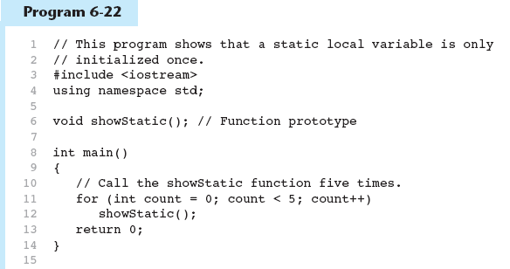
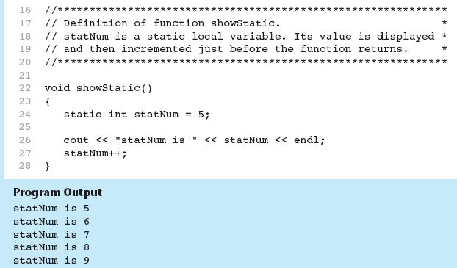
Recall Static Local Variable

Slide 4
Instance and Static Members
instance variable: a member variable in a class. Each object has its own copy.
static variable: one variable shared among all objects of a class
static member function: can be used to access static member variable; can be called before any objects are defined

Slide 5
Ex: Static Member Variable
See Program6.1 and Program6.2 on page 154.

Slide 6
static member variable (can skip)
Contents of Tree.h
1 // Tree class
2 class Tree
3 {
4 private:
5 static int objectCount; // Static member variable.
6 public:
7 // Constructor
8 Tree()
9 { objectCount++; }
10
11 // Accessor function for objectCount
12 int getObjectCount() const
13 { return objectCount; }
14 };
15
16 // Definition of the static member variable, written
17 // outside the class.
18 int Tree::objectCount = 0;
Static member declared here.
Static member defined here.

Slide 7
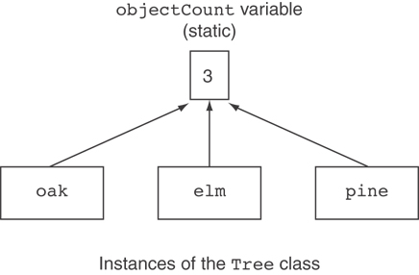
Three Instances of the Tree Class, But Only One objectCount Variable
(can skip)

Slide 8
static member function
Declared with static before return type:
  static int getObjectCount() const
  { return objectCount; }
Static member functions can only access static member data
Can be called independent of objects:
int num = Tree::getObjectCount();

Slide 9
Modified Version of Tree.h
1 // Tree class
2 class Tree
3 {
4 private:
5 static int objectCount; // Static member variable.
6 public:
7 // Constructor
8 Tree()
9 { objectCount++; }
10
11 // Accessor function for objectCount
12 static int getObjectCount() const
13 { return objectCount; }
14 };
15
16 // Definition of the static member variable, written
17 // outside the class.
18 int Tree::objectCount = 0;
Now we can call the function like this:
cout << "There are " << Tree::getObjectCount()
<< " objects.\n";

Slide 10
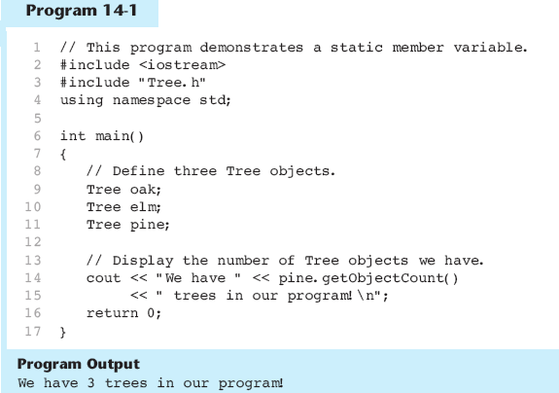

Slide 11
Week 9.2
Friends of Classes

Slide 12
Friends of Classes
Friend: a function or class that is not a member of a class, but has access to private members of the class
A friend function can be a stand-alone function or a member function of another class
It is declared a friend of a class with friend keyword in the function prototype

Slide 13
friend Function Declarations
Stand-alone function:
  friend void setAVal(intVal&, int);
  // declares setAVal function to be
  // a friend of this class
Member function of another class:
  friend void SomeClass::setNum(int num)
  // setNum function from SomeClass
  // class as a friend of this class

Slide 14
friend Class Declarations
Class as a friend of a class:
  class FriendClass
  {
  ...
  };
  class NewClass
  {
  public:
  friend class FriendClass;
  // declares entire class
  //FriendClass as a friend
  // of this class
  …
  };

Slide 15
See program examples:
  frens1.cpp
  frens2.cpp
  frens3.cpp

Slide 16
Exercise Week 9_2
Refer to Lab 6, Exercise 2 No. 2 in pages 160-162.
  Program6_10
  Program6_11
Solve the problem.

Slide 17
Week 9.3
Memberwise Assignment

Slide 18
Memberwise Assignment
Can use = to assign one object to another, or to initialize an object with an object’s data
Copies member to member. e.g.,
  instance2 = instance1; means:
  copy all member values from instance1 and assign to the corresponding member variables of instance2
Use at initialization:
  Rectangle r2 = r1;

Slide 19
See program example
  MemAsg.cpp

Slide 20
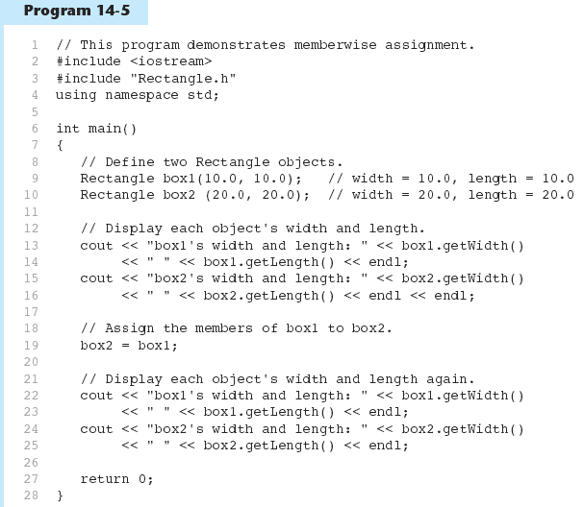
Example
Memberwise Assignment
Program 13-5

Slide 21
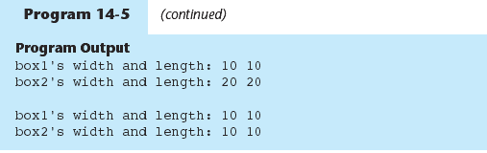
Example
Memberwise Assignment
Program 13-5 Continued

Slide 22
Week 9.3
Copy Constructors

Slide 23
Copy Constructors
Special constructor used when a newly created object is initialized to the data of another object of same class
Default copy constructor copies field-to-field
Default copy constructor works fine in many cases

Slide 24
Copy Constructors
Problem: what if object contains a pointer?
class SomeClass
{ public:
  SomeClass(int val = 0)
  {value=new int; *value = val;}
  int getVal();
  void setVal(int);
  private:
  int *value;
}

Slide 25
Copy Constructors
What we get using memberwise copy with objects containing dynamic memory:
    SomeClass object1(5);
    SomeClass object2 = object1;
    object2.setVal(13);
    cout << object1.getVal(); // also 13
13
object1
object2
value
value

Slide 26
Programmer-Defined
Copy Constructor
Allows us to solve problem with objects containing pointers:
SomeClass::SomeClass(const SomeClass &obj)
{
  value = new int;
  *value = obj.value;
  }
Copy constructor takes a reference parameter to an object of the class

Slide 27
Programmer-Defined
Copy Constructor
Each object now points to separate dynamic memory:
    SomeClass object1(5);
    SomeClass object2 = object1;
    object2.setVal(13);
    cout << object1.getVal();
    // still 5
5
13
object1
object2
value
value

Slide 28
Programmer-Defined
Copy Constructor
Since copy constructor has a reference to the object it is copying from,
  SomeClass::SomeClass(SomeClass &obj)
it can modify that object.
To prevent this from happening, make the object parameter const:
  SomeClass::SomeClass(const SomeClass &obj)

Slide 29
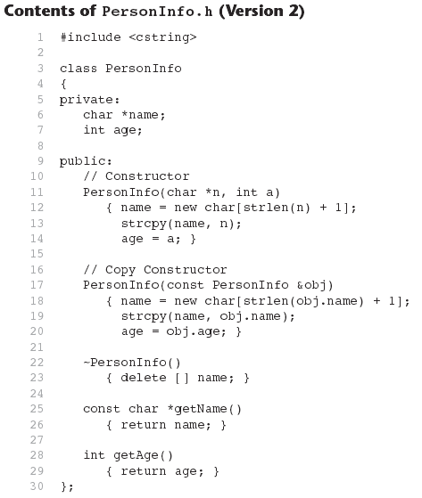
Copy Constructor

Slide 30
Week 9.4
Operator Overloading

Slide 31
Operator Overloading
Operators such as =, +, and others can be redefined when used with objects of a class
The name of the function for the overloaded operator is operator followed by the operator symbol, e.g.,
  operator+ to overload the + operator, and
  operator= to overload the = operator
Prototype for the overloaded operator goes in the declaration of the class that is overloading it
Overloaded operator function definition goes with other member functions

Slide 32
Operator Overloading
Prototype:
void operator=(const SomeClass &rval)
Operator is called via object on left side
parameter for
object on right
side of operator
return
type
function
name

Slide 33
Invoking an Overloaded Operator
Operator can be invoked as a member function:
  object1.operator=(object2);
It can also be used in more conventional manner:
  object1 = object2;

Slide 34
Example operator=
class PersonInfo
{
private:
char *name; int age;
public:
PersonInfo(char *n, int a) // Constructor
{ name = new char[strlen(n) + 1];
strcpy(name, n); age = a; }
// Copy Constructor
PersonInfo(const PersonInfo &obj)
{ name = new char[strlen(obj.name) + 1];
strcpy(name, obj.name);
age = obj.age; }
~PersonInfo() // Destructor
{ delete [] name; }
// Accessor functions
const char *getName()
{ return name; }
int getAge()
{ return age; }
// Overloaded = operator
void operator=(const PersonInfo &right)
{ delete [] name;
name = new char[strlen(right.name) + 1];
strcpy(name, right.name);
age = right.age; }
};
PersonInfo person1("Molly McBride", 27);
PersonInfo person2 = person1;

Slide 35
Returning a Value
Overloaded operator can return a value
  class Point2d
  {
  public:
  double operator-(const point2d &right)
  { return sqrt(pow((x-right.x),2)
  + pow((y-right.y),2)); }
  ...
  private:
  int x, y;
  };
  Point2d point1(2,2), point2(4,4);
  // Compute & display distance between 2 points
  cout << point2 – point1 << endl;
  // displays 2.82843

Slide 36
Returning a Value
Return type the same as the left operand supports notation like:
  object1 = object2 = object3;
Function declared as follows:
  const SomeClass operator=(const someClass &rval)
In function, include as last statement:
  return *this;

Slide 37
Example
// Overloaded = operator
const PersonInfo PersonInfo::operator=(const PersonInfo &right)
{
delete [] name;
name = new char[strlen(right.name) + 1];
strcpy(name, right.name);
age = right.age;
return *this;
}
PersonInfo person1("Molly McBride", 27);
PersonInfo person2, person3;
person3=person2=person1;

Slide 38
The this Pointer
this: predefined pointer available to a class’s member functions
Always points to the instance (object) of the class whose function is being called
Is passed as a hidden argument to all non-static member functions
Can be used to access members that may be hidden by parameters with same name

Slide 39
this Pointer Example
  class SomeClass
  {
  private:
  int num;
  public:
  void setNum(int num)
  { this->num = num; }
  ...
  };

Slide 40
Exercise Week 9_4
Write definition of the 2 overloaded operator functions
Write an appropriate main function to test the class.
class Rectangle{
int height, width;
public:
Rectangle(int a=0,int b=0)
{height=b;
width=a;}
int getWidth()
{ return width;}
int getHeight()
{ return height;}
friend Rectangle operator+(Rectangle,Rectangle);
Rectangle operator-(Rectangle);
};

Slide 41
Notes on
Overloaded Operators
Can change meaning of an operator
Cannot change the number of operands of the operator
Only certain operators can be overloaded. Cannot overload the following operators:
  ?: . .* :: sizeof

Slide 42


C++ operators that may be overloaded

Slide 43
Overloading Types of Operators
++, -- operators overloaded differently for prefix vs. postfix notation
Overloaded relational operators should return a bool value
Overloaded stream operators >>, << must return reference to istream, ostream objects and take istream, ostream objects as parameters

Slide 44
Example
class FeetInches{
private:
int feet; int inches; of inches
void simplify();
public:
FeetInches(int f = 0, int i = 0);
void setFeet(int f);
void setInches(int i);
int getFeet() const;
int getInches() const;
FeetInches operator + (const FeetInches &); // Overloaded +
FeetInches operator - (const FeetInches &); // Overloaded -
FeetInches operator ++ (); // Prefix ++
FeetInches operator ++ (int); // Postfix ++
bool operator > (const FeetInches &); // Overloaded >
bool operator < (const FeetInches &); // Overloaded <
bool operator == (const FeetInches &); // Overloaded ==
friend ostream &operator << (ostream &, const FeetInches &);
friend istream &operator >> (istream &, FeetInches &);
};

Slide 45
Example Prefix & Postfix
//Overloading prefix ++
FeetInches FeetInches::operator ++ ()
{
++inches;
simplify();
return *this;
}
//Overloading postfix ++
FeetInches FeetInches::operator ++ (int)
{
FeetInches temp(feet, inches);
inches++;
simplify();
return temp;
}
FeetInches first, second(1,5);
first=++second;
first=second++;
Dummy parameter
Copy to store data before increment

Slide 46
Example Relational
bool FeetInches::operator > (const FeetInches &right){
bool status;
if (feet > right.feet)
status = true;
else if (feet == right.feet && inches > right.inches)
status = true;
else
status = false;
return status;
}
FeetInches first, second;
//setting first & second here
if (first > second)
cout << "first is greater than second.\n";

Slide 47
Example >> & <<
ostream &operator<<(ostream &strm, const FeetInches &obj){
strm << obj.feet << " feet, " << obj.inches << " inches";
return strm;
}
istream &operator >> (istream &strm, FeetInches &obj)
{ // Prompt the user for the feet.
cout << "Feet: "; strm >> obj.feet;
// Prompt the user for the inches.
cout << "Inches: "; strm >> obj.inches;
// Normalize the values.
obj.simplify();
return strm;
}
FeetInches first;
//setting first feet=6 lnches=5
cin>>first;
cout << first;

Slide 48
Overloaded [] Operator
Can create classes that behave like arrays, provide bounds-checking on subscripts
Must consider constructor, destructor
Overloaded [] returns a reference to object, not an object itself

Slide 49
Exercise Week 9_4
Refer to lab 6, Exercise 3 No. 2 in page 158.
Solve the problem.

Slide 50
Week 9.
Object Conversion

Slide 51
Object Conversion
Type of an object can be converted to another type
Automatically done for built-in data types
Must write an operator function to perform conversion
To convert an FeetInches object to an int:
  FeetInches::operator int()
  {return feet;}
Assuming distance is a FeetInches object, allows statements like:
  FeetInches distance;
  int d = distance;

